Slide 1
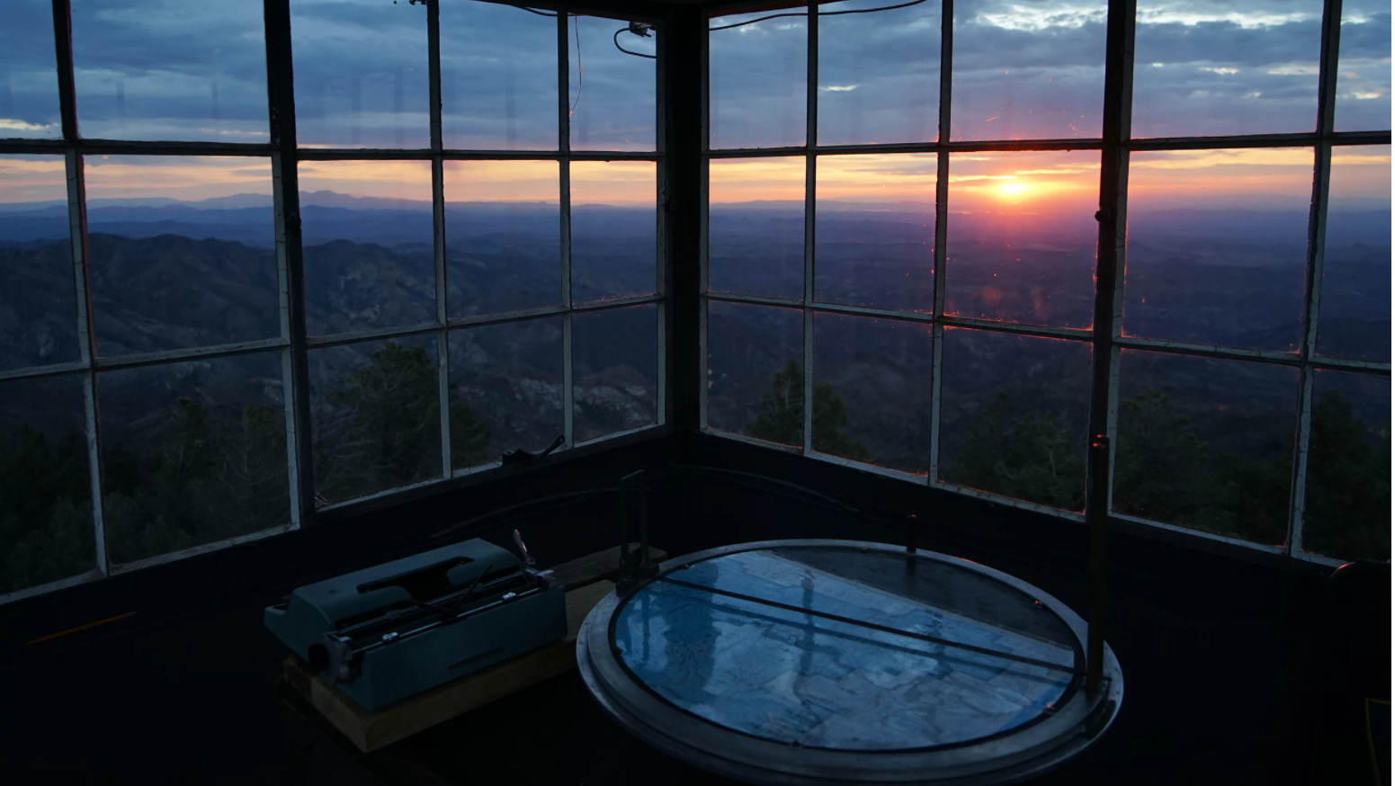
EARLY WILDFIRE DETECTION
using Machine Learning
Notes:
The idea for this project came from when I used to rent this really amazing firewatch tower & cabin with friends every summer. It’s about a mile above sea level on Bear Basin Butte and it’s amazing! One of my favorite things was this really cool instrument….you can see it here, the Osborne Fire Finder. It had a topographical map of the surrounding 360-degree area in it and the fire lookouts used to use it to sight smoke and estimate the altitude and distance to the fire.

Slide 2
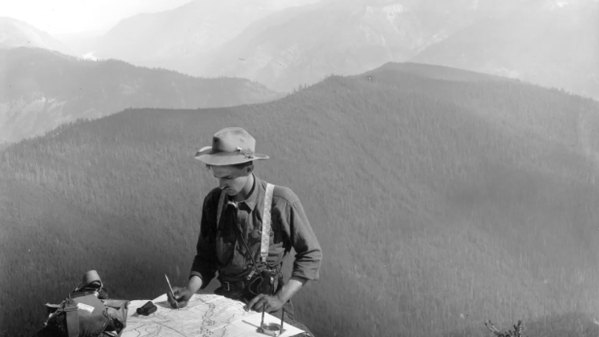
Human Lookouts
A THING OF THE PAST
Traditional fire lookouts are being phased out in favor of faster and safer fire-detection methods.
California once had 660 fire lookout towers/cabs that were manned for decades by personnel monitoring for wildfires. Since the 1990’s most of them have been retired from service as various terrestrial, aerial, and satellite-based technologies that are equipped with visible, IR, or multispectral sensors have become more commonplace. Today, only 38 of those towers remain in operation, mostly in our far northern forests.
Notes:
The reason that I was able to rent this place was because traditional firewatch towers with human lookouts have been replaced with technology and remote monitoring. California had 660 fire lookouts back in the day. But since the 1990’s most of them have been phased out except for 38 of them which remain in operation mostly up in our Northern forests.

Slide 3
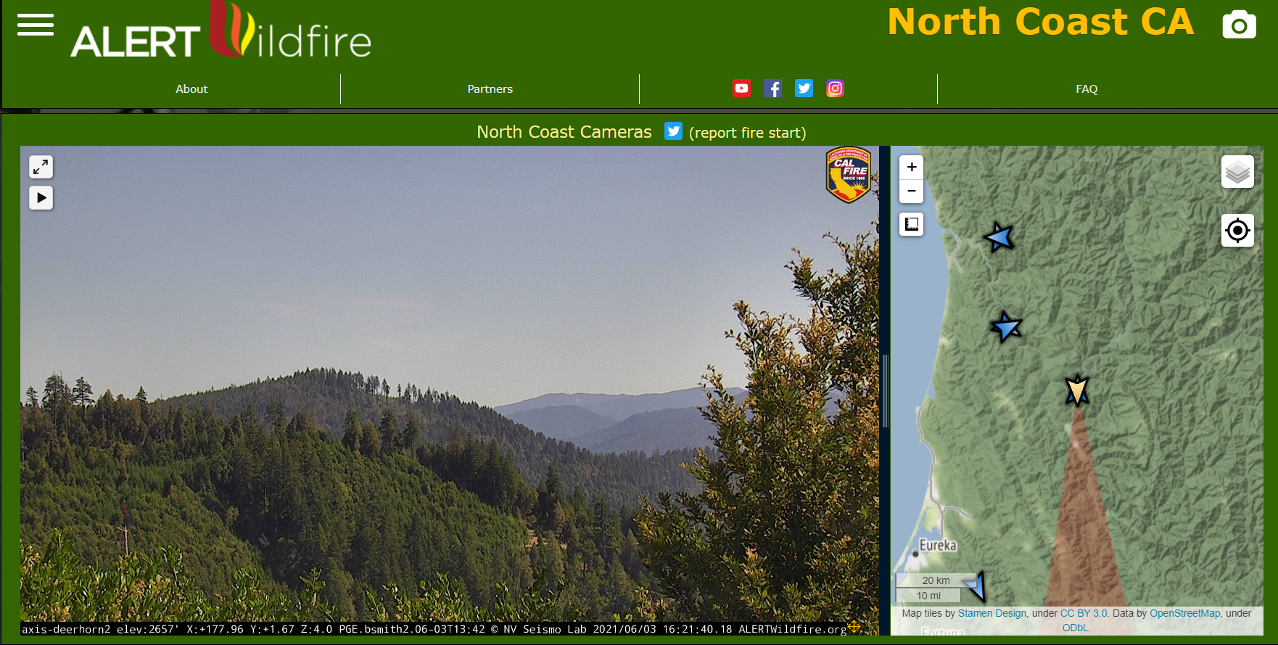
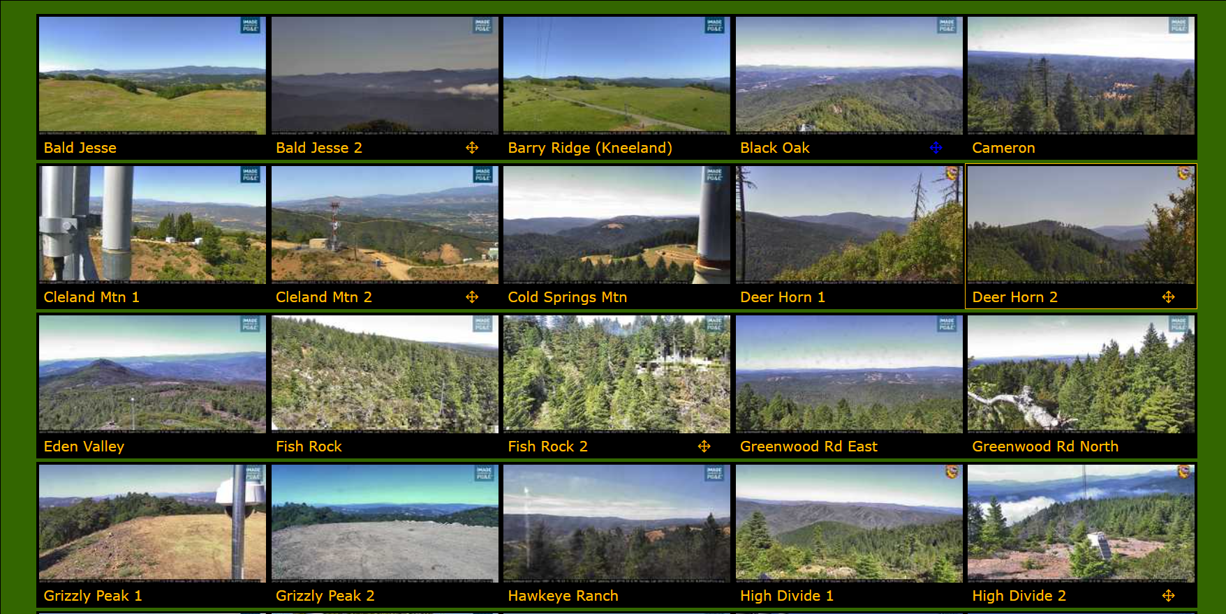
ALERT
Wildfire
NETWORK OF CAMERAS
Over the last decade, 800 PTZ (Pan-Tilt-Zoom) fire cameras have been installed across California by the HPWREN and ALERTWildfire consortiums:
https://hpwren.ucsd.edu/
http://www.alertwildfire.org/
These cameras are monitored by firefighters and the general public to detect wildfire ignition, verify & locate reported fires, and monitor wildfire behavior.
The cameras have proven highly effective for verifying and monitoring - over the last 5 years they have provided critical information for over 500 wildfires. But for people to manually detect fires using these cameras requires that they stare at them for hours on end looking for gradual changes…..a task much better suited to computers!
Notes:
One of these technologies is ALERT Wildfire. They have about 800 pan-tilt-zoom cameras for firewatching. The public can monitor these cameras and send notifications if they spot a potential wildfire. And Wildfire professionals operate these cameras in patrol mode, pointing them in different directions. You can get latitudes and longitudes and distances to spotted incidents using this tool, and you can view recent timelapse video which really helps in identifying wildfire ignition events. One of the Fire Chiefs in SoCal working closely with ALERT Wildfire says that this system can shave off 20 minutes to an hour of the time it takes for his initial response to a fire.

Slide 4
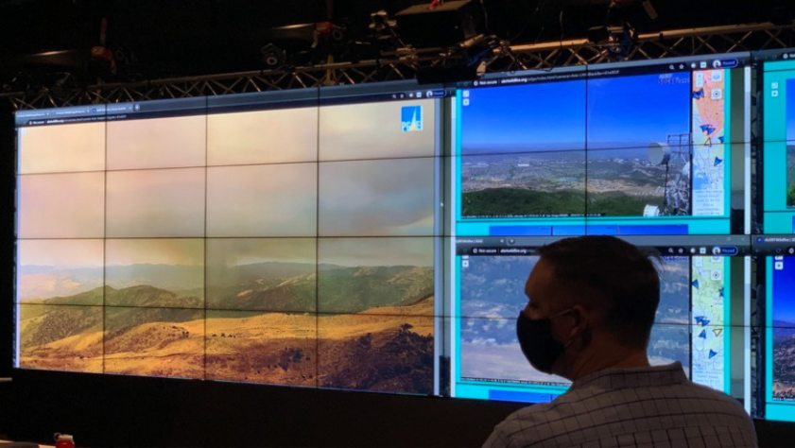
CAN WE AUTOMATE EARLY WILDFIRE DETECTION USING
MACHINE LEARNING?
Let’s find out!
Notes:
And while the system is good for verifying 911 wildfire calls & monitoring fires, it still relies on people to report these initial sightings. So even though Wildfire professionals, like this fellow here, use the ALERT Wildfire cameras to verify, locate and monitor fires, they would have to be constantly staring at every camera if they wanted to spot new wildfires breaking out.. This is a great task for a computer. So we thought we would try and see if we could apply machine learning to this problem, and automate the early detection of wildfires to alert the humans……

Slide 5
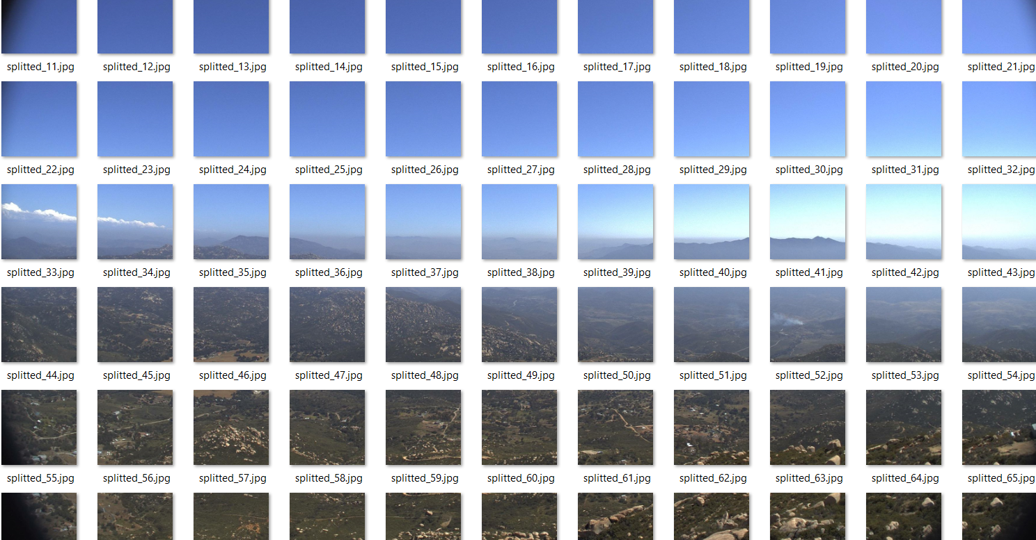
GETTING THE DATA
LOTS AND LOTS OF DATA!
Notes:
And to do that, first we had to get image data….
And we needed lots of it because these camera images are large and complex, with tons of different features (rocks, buildings, power poles, clouds, trees, hills, sky, lakes, cars, smoke, haze, reflections, shadows, birds, satellite dishes, roads, etc.) but what we wanted to train the deep learning algorithm to do was to identify the very beginning of a wildfire where you have the very small, definitive plume of smoke starting to form. If you look at this split up image you can see all kinds of stuff…..but there in tile 52 is the distinctive plume of smoke that we wanted to train it to recognize.

Slide 6
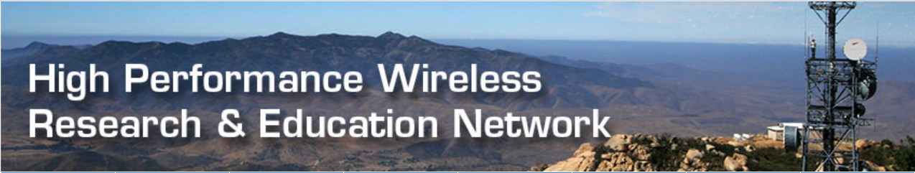
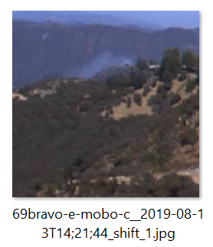
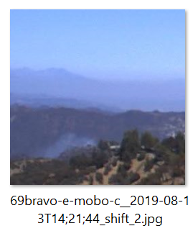
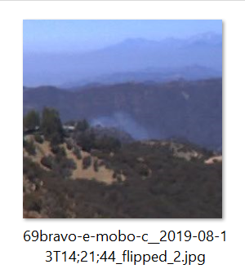
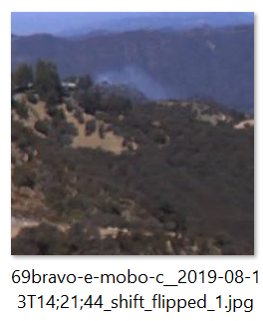

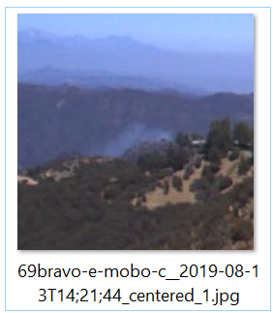
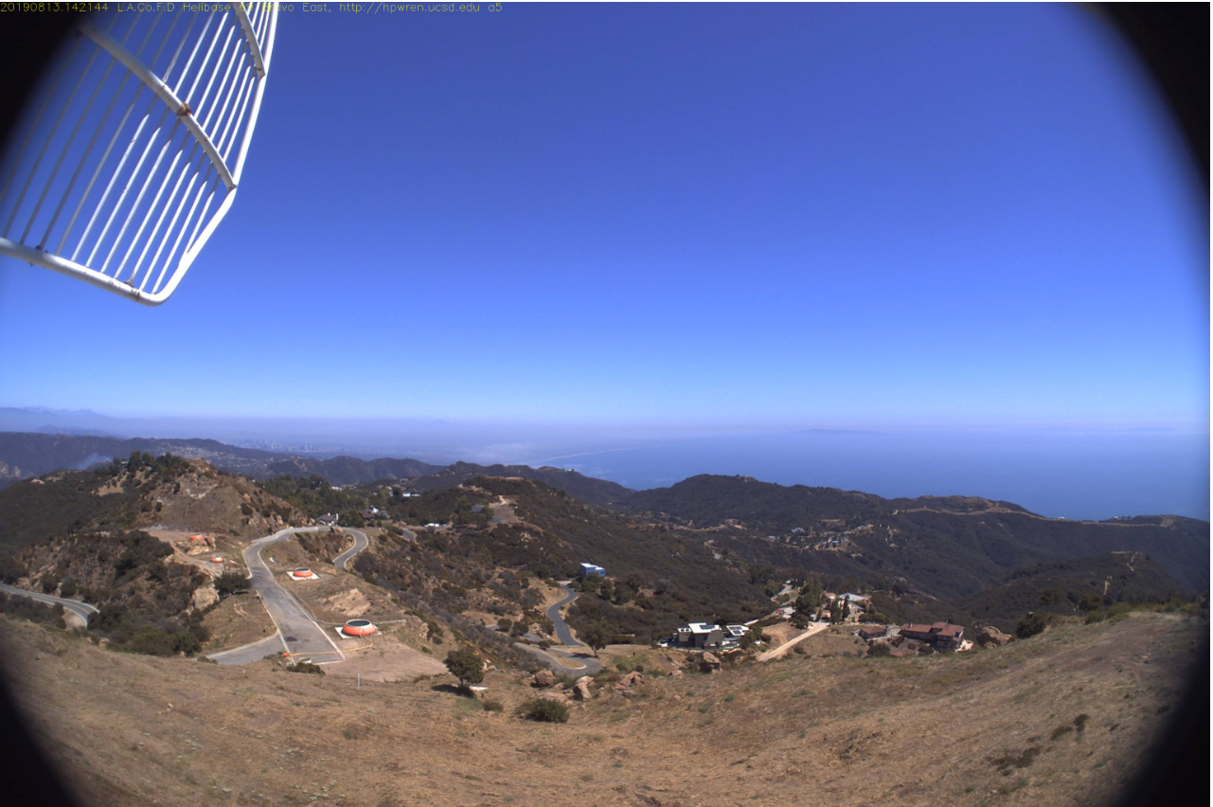
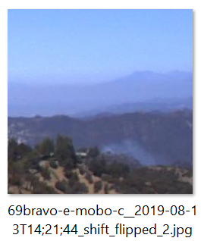
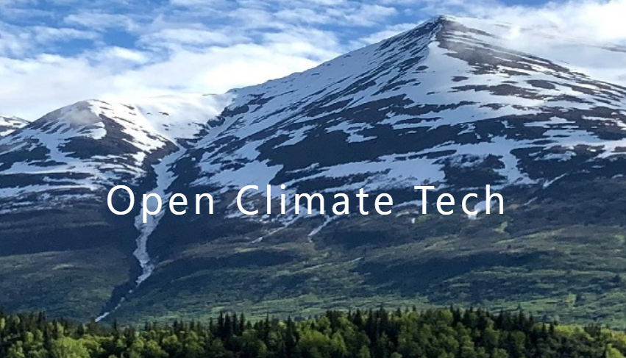
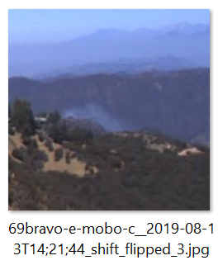
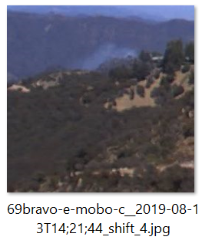
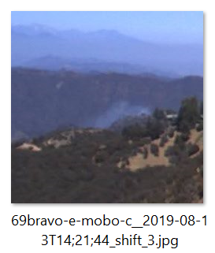
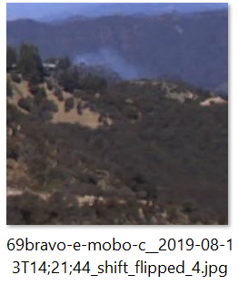
HPWREN Fire Ignition Images Library: http://hpwren.ucsd.edu/HPWREN-FIgLib/
Data Collection & Augmentation Smoke and No Smoke
- 500+ fire sequence videos from 2016-2020
- full-sized fixed camera images for all of them
- We selected several hundred images and annotated the bounding box coordinates of smoke segments
Boosted dataset of 2,300 smoke images to 16,000 by flipping and shifting
16,000 no smoke images
2,300 smoke images
- 1800 full-size fixed camera images w/ smoke
- .csv file with the bounding box coordinates
- 40,000 299x299 no smoke images
OCT Github repo: https://github.com/open-climate-tech/firecam/tree/master/datasets/2019a
Notes:
Fortunately, we found a couple of good resources of image data to help get us started…..the High Performance Wireless Research & Education Network or HPWREN, and Open Climate Tech. So we basically started out with 16,000 no smoke images and 2,300 smoke images to feed our neural net. But we needed a balanced dataset in order to train the neural net without bias, and we needed 299x299 pixel images to feed the neural net. If we resized the full images down to 299x299 pixels, the plume of smoke would be so small that the neural net would never be able to identify it. So we wrote a program that took these 2,300 full size images and turned them into 16,000 smaller images by shifting and flipping them. You can see here the central camera image annotating the tiny smoke plume – and if you look at the surrounding images you can see the subimages that we extracted from it. This gives the neural net more examples of smoke plumes to learn from and helps it to recognize them in a more flexible, context-free manner.

Slide 7

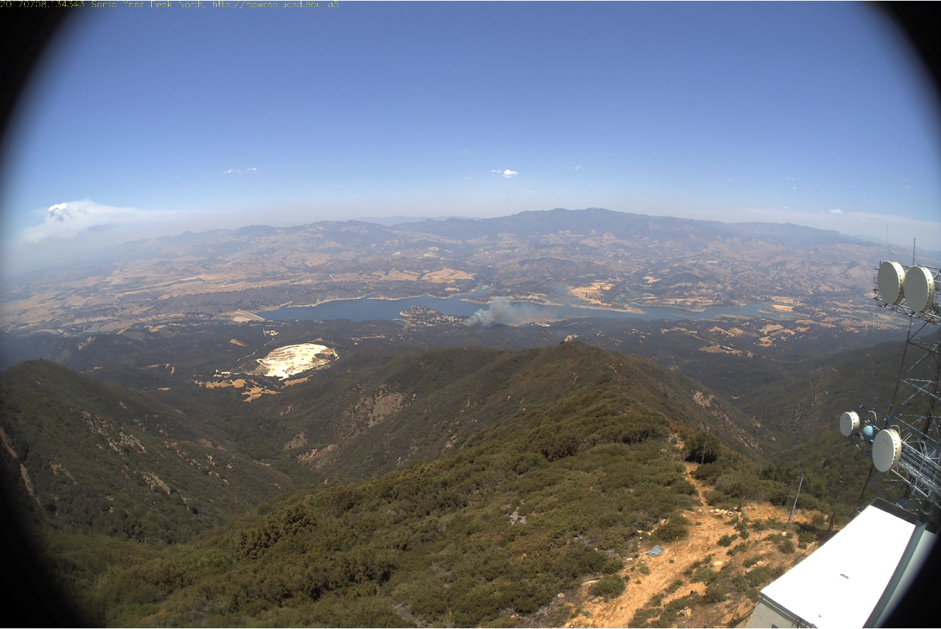

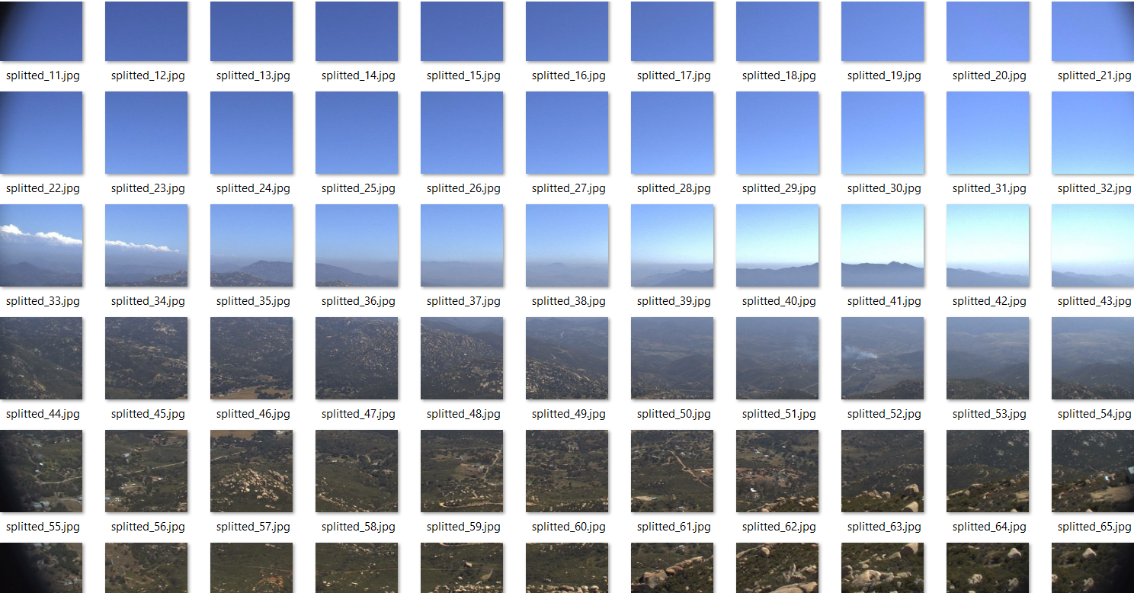

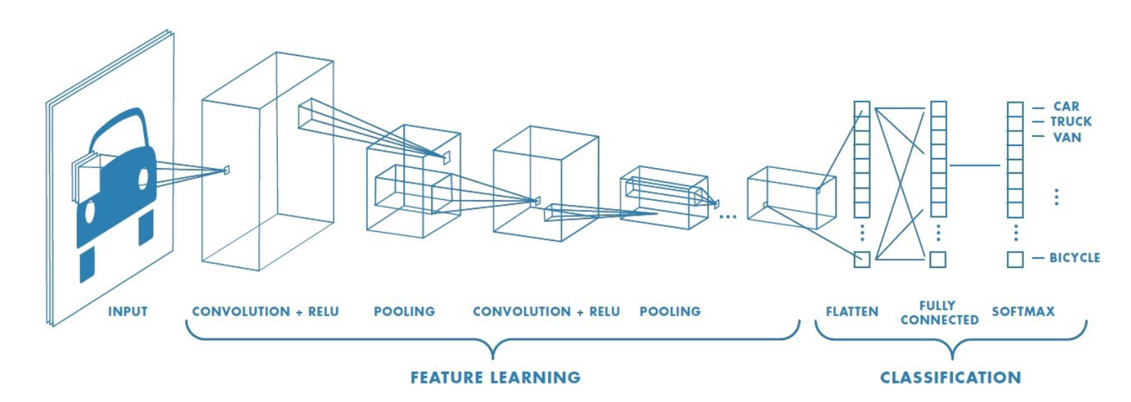
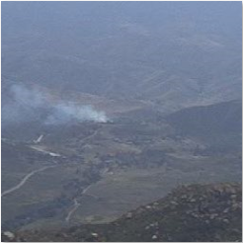
Early Wildfire Image Classification Convolutional Neural Network
http://hpwren.ucsd.edu/HPWREN-FIgLib/HPWREN-FIgLib-Data/20170708_Whittier_syp-n-mobo-c/20170708-Whittier-syp-n-mobo-c.mp4
Full 3072 x 2048
pixel image
SMOKE
NO
SMOKE
~70 299 x 299
sub images
SIGMOID
299 x 299
pixel sub image
(FILTER, DETECT, CONDENSE)
Notes:
So the way it works is we grab an image, like this one from the beginning of the Whittier fire sequence.
We then split those images into 299x299 subimages and pass them to our convolutional neural net one at a time.
The convolution layer of the neural net filters them to find basic features (like edges, lines, shadows, etc.), that it passes to the ReLU layer which transforms them and output them to a pooling layer where they are condensed. These are then passed to another convolution layer and this all happens again and again…..each time the neural net is learning higher-level features….where the first layers were detecting very basic shapes, the later layers can detect combinations of shapes – basically objects/things. The classification layers then flatten all of that data and learn to associate the learned shapes with the actual classification objects –in our case outputting the probability percentage of the image containing smoke or not..

Slide 8

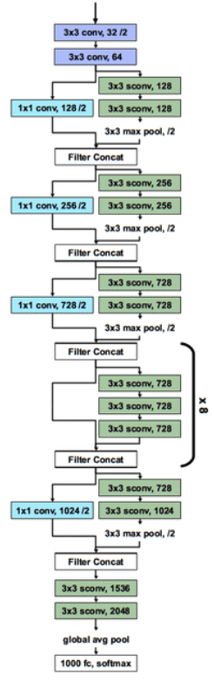
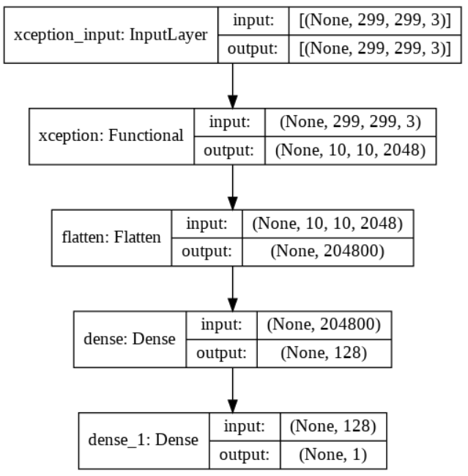
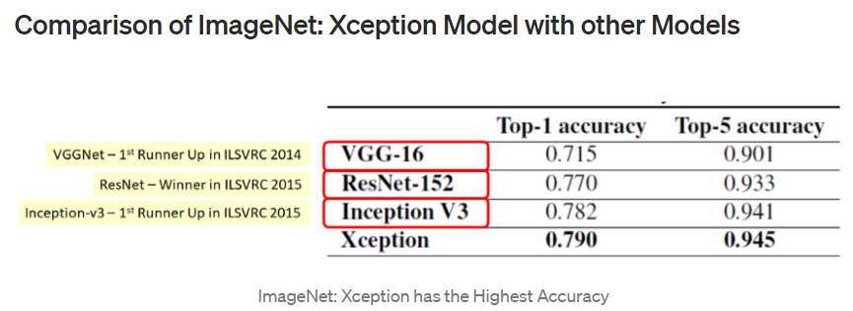
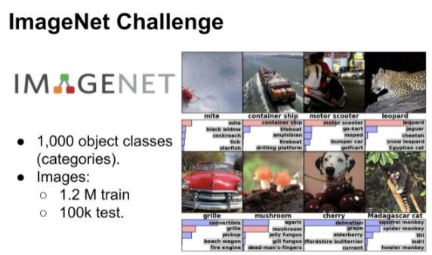
Wildfire Detection Convolutional Neural Net Transfer Learning Architecture
Streamline1 CNN
Xception
pre-trained
CNN
The Trained Base:
feature extraction
The Head: Classification
Notes:
Because we are dealing with really complex images containing a ton of different features (rocks, buildings, clouds, etc.), we decided to leverage Xception in our neural net architecture. Xception is a cnn that was trained on over 1.2 million images from the Imagenet database and can recognize over a thousand different objects like ships, motor scooters, mushrooms, cats and whatnot.. We decided to use it for our feature extraction layers, and we added on a few final layers to do the classification. So our neural looks like this: If you look at the functional layer, it actually contains Xception, which has 36 convolutional layers.

Slide 9
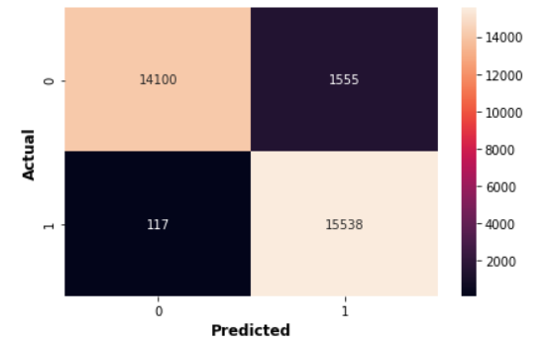
True Accuracy
Comparing Versions
MediumXception(V1): True Accuracy 90.76%
True Positives: 41.54%
True Negatives: 49.23%
False Positives: 6.92%
False Negatives: 2.31%
LargeXception (V2): True Accuracy 93.49%
True Positives: 49.1%
True Negatives: 44.4%
False Positives: 5.6%
False Negatives: 0.9%
Streamline1 (V3): True Accuracy 94.66%
True Positives: 49.63%
True Negatives: 45.03%
False Positives: 4.97%
False Negatives: 0.37%
Streamline1 Confusion Matrix
Notes:
We trained several versions of our neural net and here you can see true accuracy improved from 90.76 to 93.49 to 94.66.
The the false negatives, the cases where the model doesn’t recognize an actual early ignition event, were too high to start. So we focused on bringing that down with subsequent training runs, which we did a good job with. But the false positive rate is still too high. Even though we have improved the false positive rate, 1 out of 20 images without early ignition events still get flagged as having them……

Slide 10
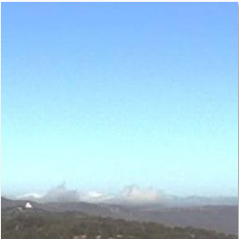
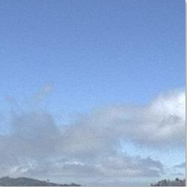
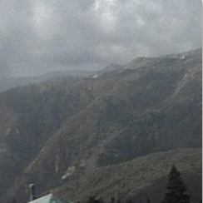
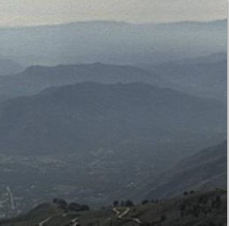
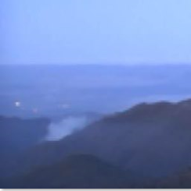
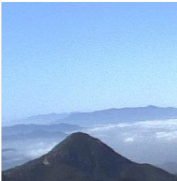
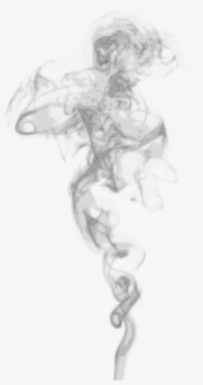
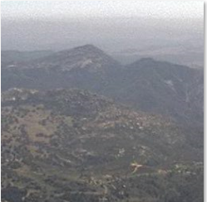
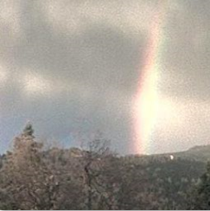
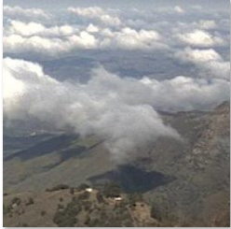
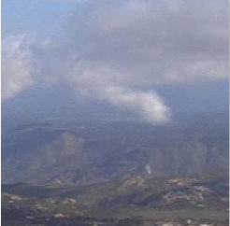
False Positives Mostly clouds and haze
Notes:
Most of those false positives are clouds and smoky haze….you can see some examples here.
So basically the model has gotten good at recognizing smoke generally, but it needs to get better at distinguishing clouds from smoke plumes, and recognizing these distinctive plumes of smoke of a fire starting rather than the more dispersed smoke that collects in areas where there are active fires.
Our next model will be much better, but unfortunately we didn’t have time to train it for today ☺
But the model is just one part of our prototype – now Michael will talk a bit about the overall system and how it is architected…..

Slide 11








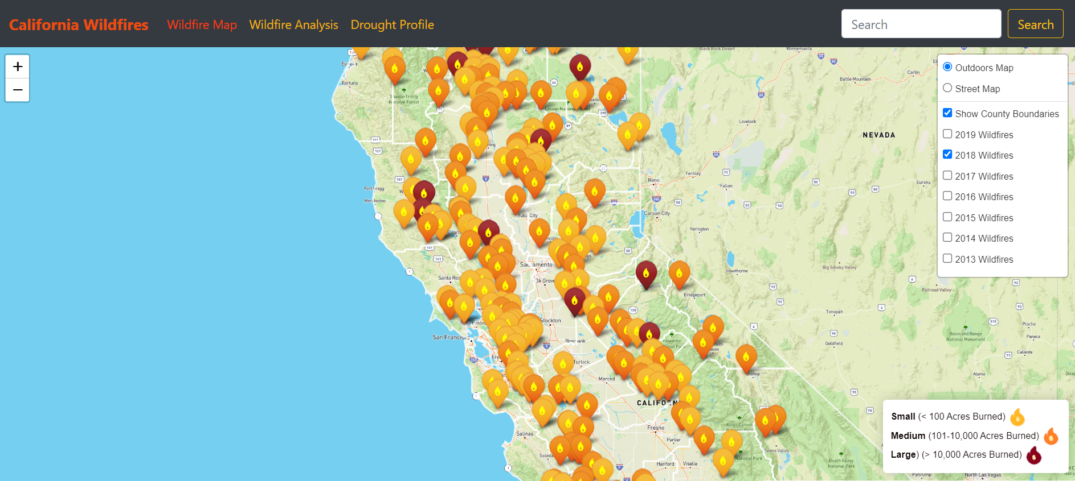
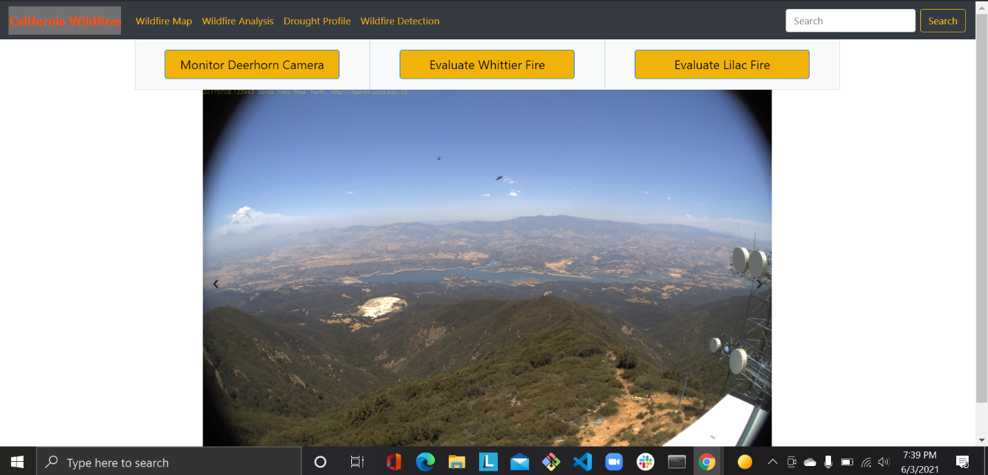
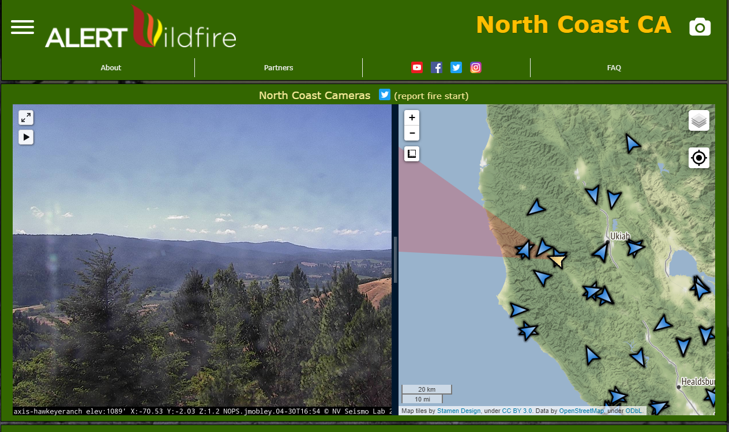

Early Wildfire Detection System Solution Architecture
Flask API serving up query endpoints
Convnet model deployed on server
Image Evaluation Request
Scrape current camera image
Image Evaluation response
ALERT Wildfire webcam
Wildfire Detection Web Client

Slide 12
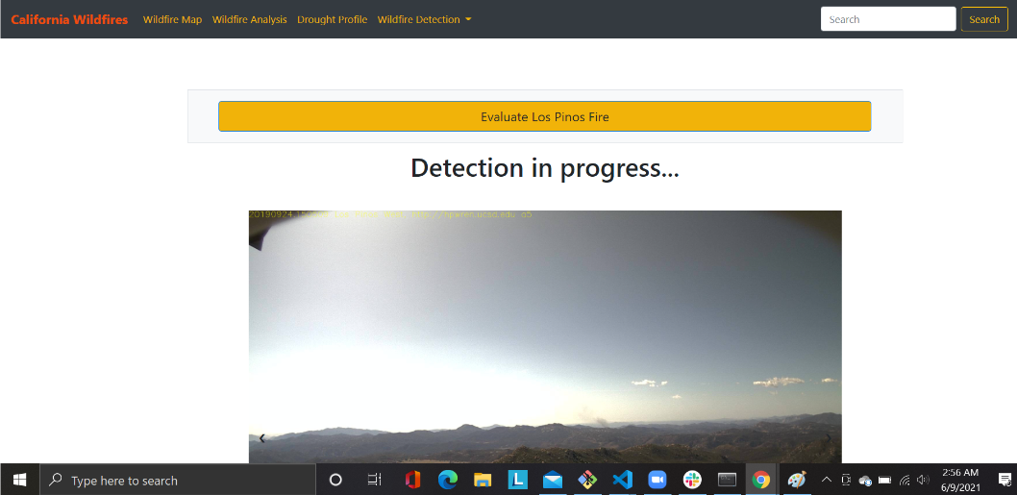
DEMO
Notes:
Go to AlertWIldfire North Coast website and show the Deerhorn webcam page…”The idea is that a neural net like ours could monitor all these camera feeds and alert Wildfire professional when a potential wildfire is detected.”
Go to our Wildfire Detection page and click “Monitor Deerhorn camera”….”Let’s see if there’s any fire on the Deerhorn camera near Margaret today. Now, if we were an Alert Wildfire network partner we could directly download the video and image files, but since we are not we have to web scrape the camera images.”
Hopefully, it doesn’t return any smoke predictions.
Unfortunately, it may return a false positive or two depending on the time of the day…..how does it test out now?
“Now let’s see how the system does with a real fire……this is a sequence of images from the Lilac Fire, a fire that broke out near San Diego in 2017 that burned 4,100 acres, destroyed 157 structures and cost $9M in property damage and firefighting expenses……” Can show the Wildfire map for 2017 with the Lilac fire on it.
Show Lilac video
Click “Evaluate Lilac Fire”…
Hopefully it just highlights the two subimages where there is active smoke.

Slide 13



Thanks!
Margaret Thorpe
Michael Regpala
Efrain Lopez
Wildfire Lookout
Wildfire Spotter
Wildfire Scout
Image data queen. Neural net whisperer.
Master data wrangler. Server and API wizard.
Image data extraction specialist. Web conjuror..

Slide 14

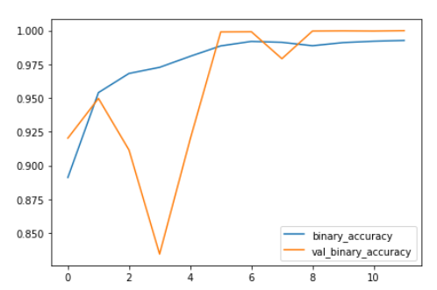
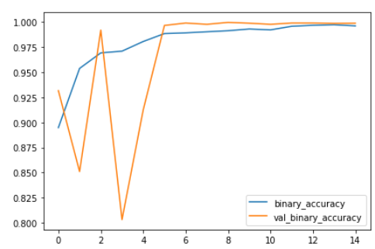
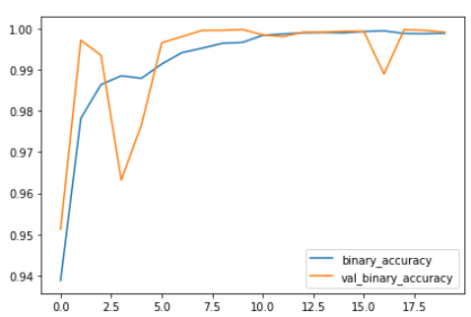
Training & Validation
Streamline2 (V4):
Tensorflow version 2.5.0
Running on TPU ['10.11.174.146:8470']
Your runtime has 37.9 gigabytes of available RAM
You are using a high-RAM runtime!
Found 35025 files belonging to 2 classes. Using 28020 files for training.
Found 35025 files belonging to 2 classes. Using 7005 files for validation.
Epoch 1/15
Streamline1 (V3):
Found 31310 files belonging to 2 classes. Using 25048 files for training. Found 31310 files belonging to 2 classes. Using 6262 files for validation.
Epoch 12/12
loss: 0.0192 - binary_accuracy: 0.9926
val_loss: 3.2564e-04 - val_binary_accuracy: 0.9998
LargeXception (V2):
Found 31310 files belonging to 2 classes. Using 25048 files for training. Found 31310 files belonging to 2 classes. Using 6262 files for validation.
Epoch 15/15
loss: 0.0092 - binary_accuracy: 0.9962
val_loss: 0.0035 - val_binary_accuracy: 0.9989
MediumXception (V1):
Found 23098 files belonging to 2 classes. Using 18479 files for training.
Found 23098 files belonging to 2 classes. Using 4619 files for validation.
Epoch 20/20
loss: 0.0040 - binary_accuracy: 0.9989 -val_loss: 0.0044 - val_binary_accuracy: 0.9991
Notes:
So we trained and validated several different versions of this neural net…..V1 is at the bottom, V4 at the top.
We increased the size of our training dataset from one version to the next and tried different tuning parameters.
We got generally good training & validation accuracy, but were unable to train with our final version of the dataset because we couldn’t enough machine resources to. Unfortunately, this final dataset would have addressed an issue that our current model is having with false positives……
,

Slide 15

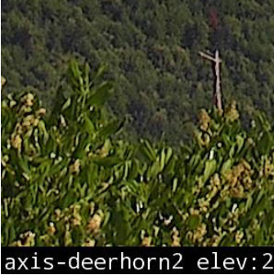
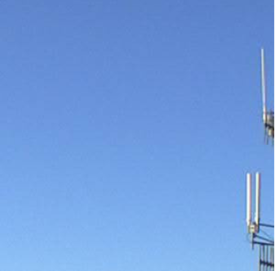
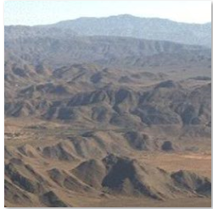
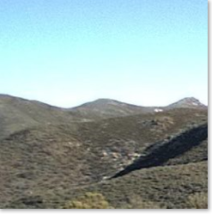




False Positives Also some real head scratchers

